Slide 1
PHYSICAL DFD

Slide 2
LEVEL 0

Slide 3
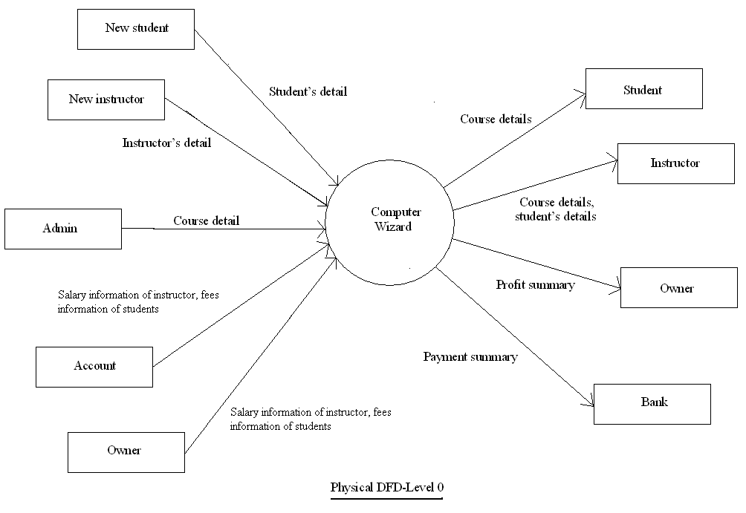

Slide 4
LEVEL 1

Slide 5
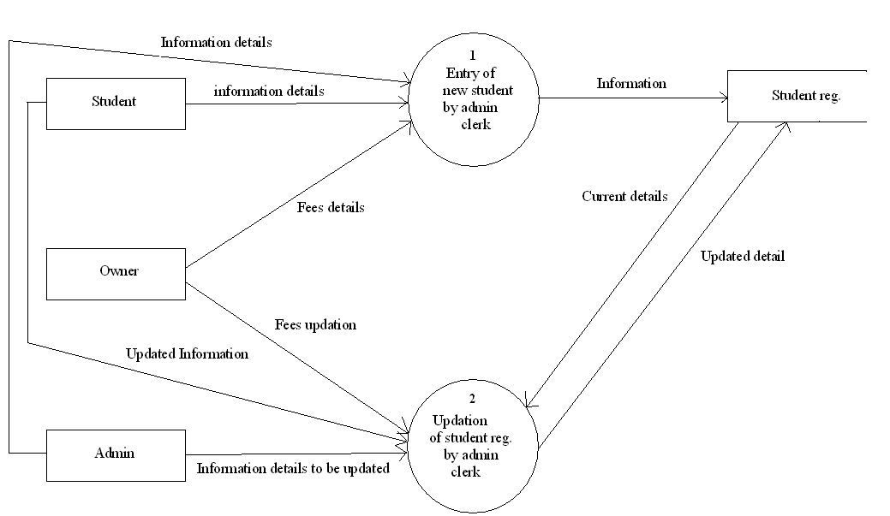

Slide 6
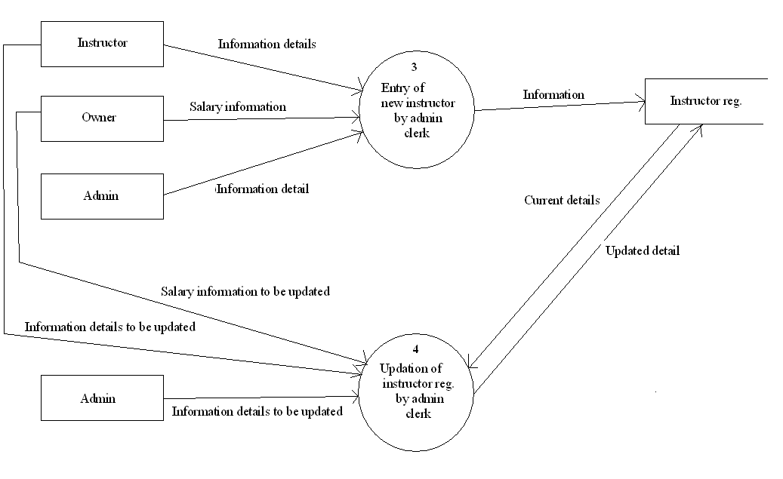

Slide 7
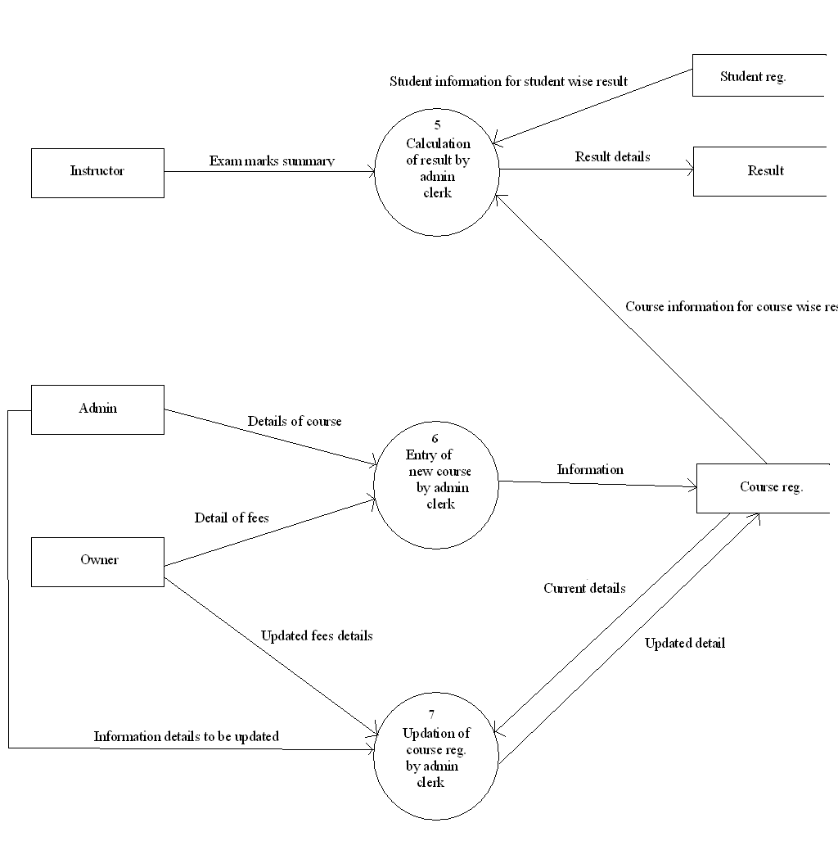

Slide 8
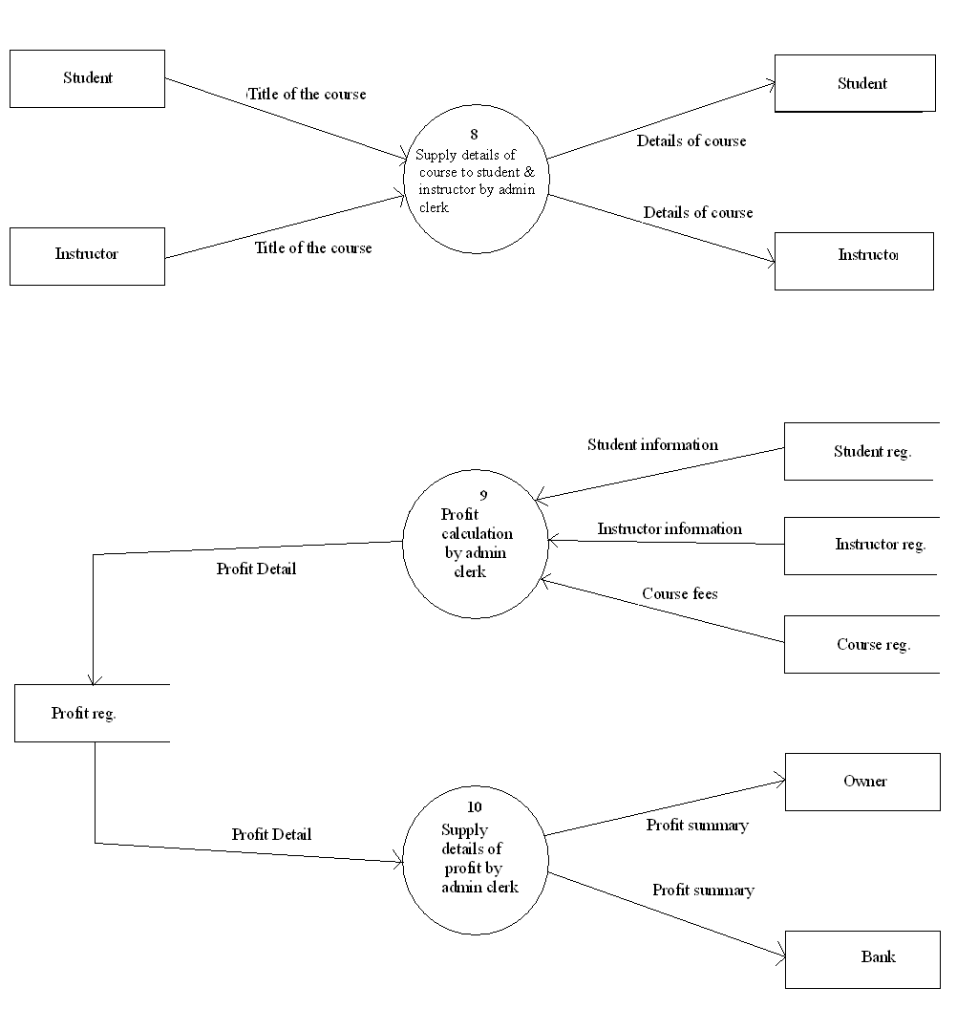

Slide 9
LOGICAL DFD

Slide 10
LEVEL 0

Slide 11
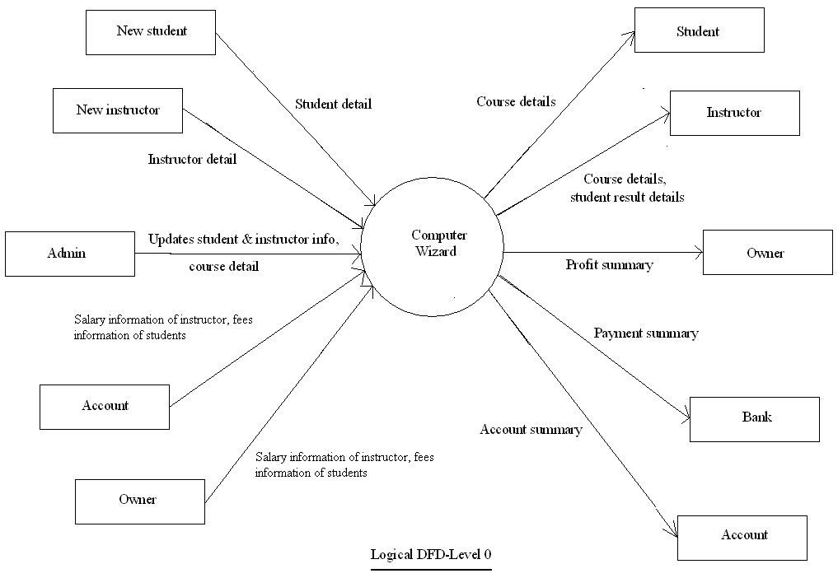

Slide 12
LEVEL 1

Slide 13
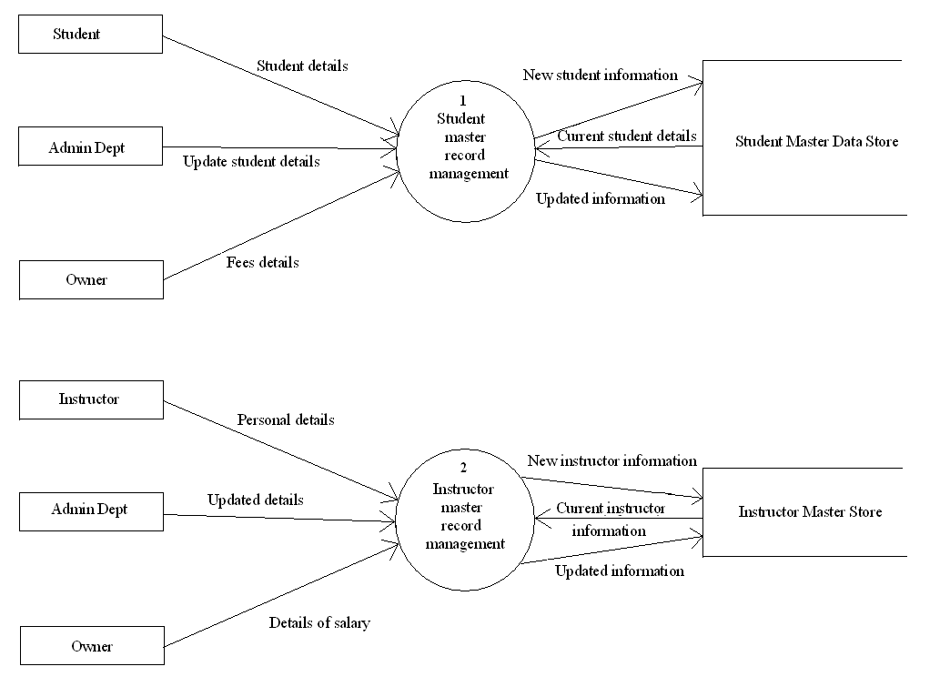

Slide 14
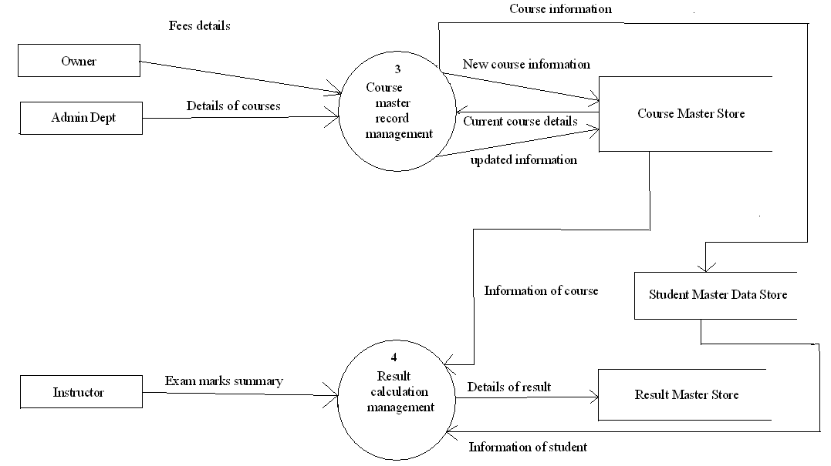

Slide 15
